Slide 1

Sarower Ahmmed

Slide 2
//Launch FireFox
//Open google
//find search box and Type Fahim Brooklyn
//find search button and Click
//capture Number of search result
// close browser

Slide 3
Webdriver interface
interface
Interface: a method To drive browser
FindElement(),GetTitel(),Get Current Url(),Close()
Same method for all
Browser
Firefox,Chrome,IE,
others

Slide 4
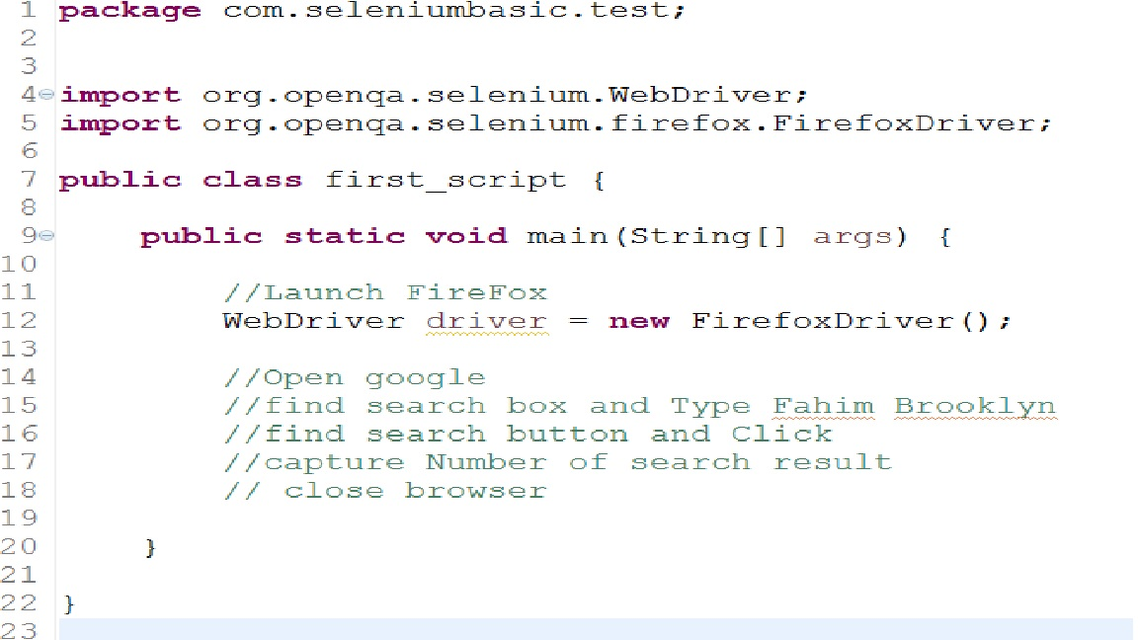
How to open browser:

Slide 5
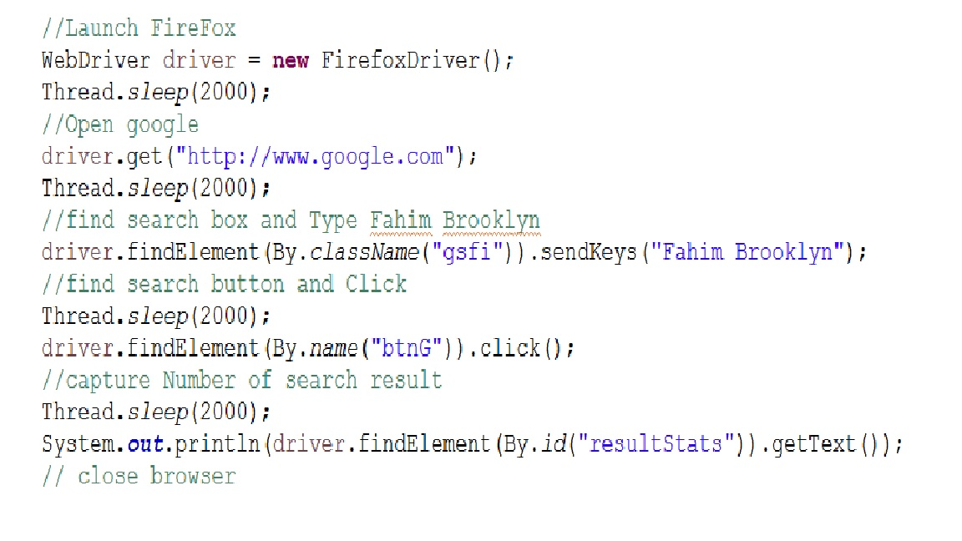
driver.close();

Slide 6
Selenium WebDriver | WebDriver | Driver | FirefoxDriver | ChromeDriver | InternetExplore Driver
API | API | API | API | API | API
Framework | Drive browser | Who drive | Drive Firefox | Driver Chrome | Drive IE
JARs, Plugins, dependencies, Methods | JARs, Methods | Methods | JARs, Methods | JARs, Methods | JARs, Methods

Slide 7
Maven | TestNg/Junite | Eclipse/STS/Visual studio
Build Tool | Framework helper/code writing or runner helper | IDE
Jenkins | Git/SVN/TFS | Cucumber/Specflow | SOAP UI | Jmeter/ LoadRunner
CI + CS | Version control | BDD/ATDD | Web service Testing(SOAP & REST) | Performance + API testing

Slide 8
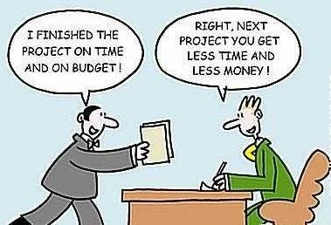
THANKS

Slide 9
What is Locator?
Locator can be termed as an address that identifies a web element uniquely within the webpage.
Locators are the HTML properties of a web element which tells the Selenium about the web element it need to perform action on.

Slide 10
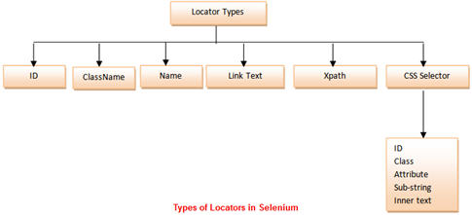

Slide 11
There is a diverse range of web elements. The most common amongst them are:
Text box
Button
Drop Down
Hyperlink
Check Box
Radio Button

Slide 12
Synchronization:
3 kinds
1)Implicite
2)Explicite
3)Fluent
Also can use for synchronization:
Thread.sleep(500) or SetTimeout
QTP in sec but selenium in mili

Slide 13
Default wait time in QTP=10 sec but Selenium =0 sec
Implicit wait --
Implicit waits are basically your way of telling WebDriver the latency that you want to see if specified web element is not present that WebDriver looking for. So in this case, you are telling WebDriver that it should wait 10 seconds in cases of specified element not available on the UI (DOM).
Explicit wait--
Explicit waits are intelligent waits that are confined to a particular web element. Using explicit waits you

Slide 14
Implicit wait(QTP wait) | Explicit wait(wait property)
Means = wait certain amount of time(10sec) before no such element Exception. | Wait certain amount of time(20 sec) for Expected condition
Apply for all element of script | Apply only which element are selected
No need condition | Need condition such as- Visibility of all element(), visibility of all elementlocated()
Example: driver.manage().timeout.implicitewait(10,TimeUnit.SECOND) | Example: WebDriverWait wait =new WebDriverWait (WebDriverRefence.TimeOut)

Slide 15
 | abstract Classes | Interfaces
1 | abstract class can extend only one class or one abstract class at a time | interface can extend any number of interfaces at a time
2 | abstract class can extend from a class or from an abstract class | interface can extend only from an interface
3 | abstract class can have both abstract and concrete methods | interface can have only abstract methods
4 | A class can extend only one abstract class | A class can implement any number of interfaces
5 | In abstract class keyword ‘abstract’ is mandatory to declare a method as an abstract | In an interface keyword ‘abstract’ is optional to declare a method as an abstract
6 | abstract class can have protected , public and public abstract methods | Interface can have only public abstract methods i.e. by default
7 | abstract class can have static, final or static final variable with any access specifier | interface can have only static final (constant) variable i.e. by default

Slide 16
JENKEN
To run unattended test cases
Running test in different machine and non developer machine
For continues integration testing
Also can tell
For task scheduleing
Also for task maintaining

Slide 17
Constructor
A constructor in Java is a block of code similar to a method that’s called when an instance of an object is created. Here are the key differences between a constructor and a method:
A constructor doesn’t have a return type.
The name of the constructor must be the same as the name of the class.
Unlike methods, constructors are not considered members of a class.
A constructor is called automatically when a new instance of an object is created

Slide 18
Object Oriented Programming (OOPs)
Combination of Data & Action

Slide 19
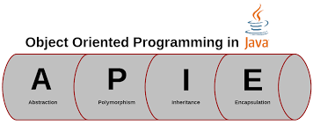
Advantage of OOP

Slide 20
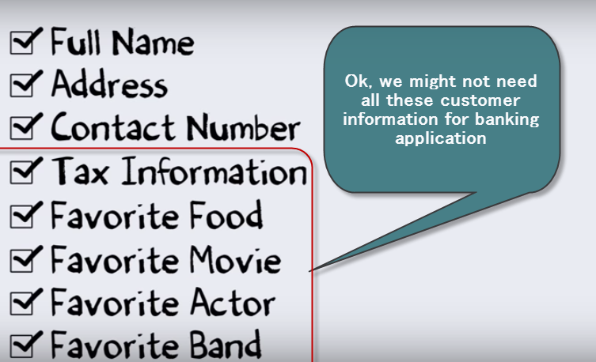
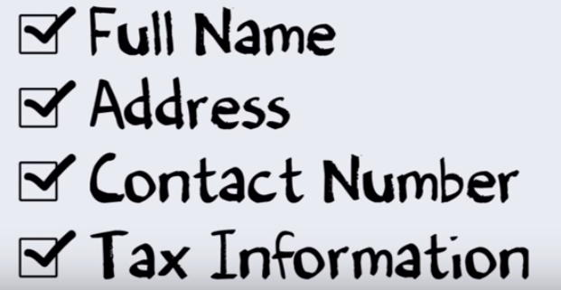
Abstraction
Selecting important data sets,
Leaving out the insignificant ones

Slide 21
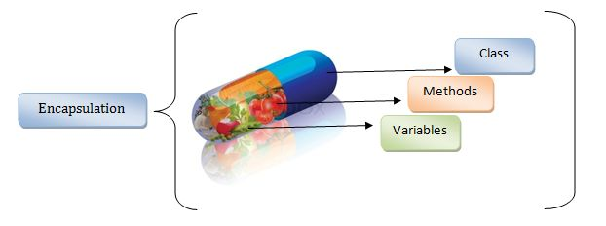
Encapsulation
With Encapsulation you can hide (restrict access) to critical data members in your code , which improves security
Encapsulation combines data and actions together (just like a capsule).

Slide 22
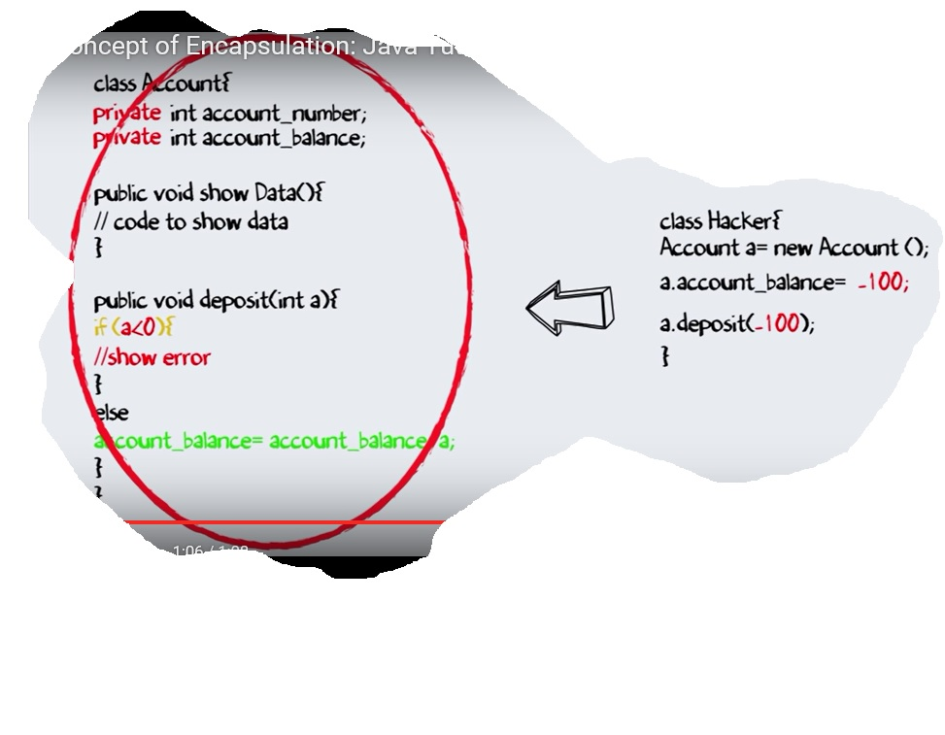

Slide 23
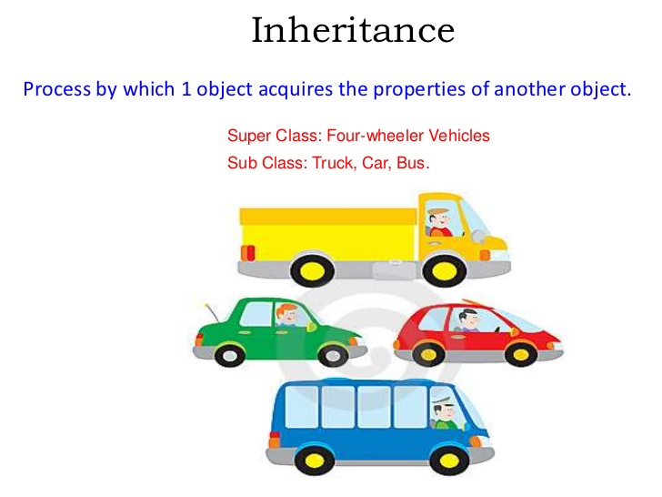
.

Slide 24
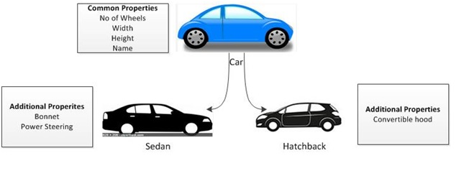
Polymorphism: Is the ability of methods to behave differently , based on the object calling it

Slide 25
Withdraw ()
Deposit ()
Parent: Account
Special features for CC ()
Special feature ()
Saving
Checking
Credit Card
Privileged

Slide 26
JAVA Programing Structure
public class Hello
{
public static void main(String[] args)
{
System.out.println("Hello Java");
}
}

Slide 27
Class structure
public class class_name
{
Data Members;
Methods;
}
public class Car
{
Public:
double color; // Color of a car
double model; // Model of a car
}

Slide 28
What is Class??
Represent object
Also data member & method
Types:
Public- access from outside of class
Private- access only from within class
Protected- not access
Default

Slide 29
Public static void main
Public = Accessible from any other classes(Access modifier)
Static = it is unique/non access modifier/return nothing/return something/non changeable
Void = this is main method and has return nothing
Main = a method where the program start

Slide 30
Some terminology
Object: means behavior
Object type: one dimensional, two or multi dimensional
Function: What ever object do or object value.
Thread: Run time code execution
CSS(cascade Style sheet)
Mouse Hover (mouse over any thing in the page)

Slide 31
Synchronization:3 kind
1)Implicite
2)Explicite
3)Fluent
Use for synchronization: wait or Thread.sleep(500) or SetTimeout

Slide 32
Locator
ID
Class
Name
TagNmae
CSSLocator
Linktext
Xpath: code
a) common object: //ID/Tagname/Linktext
b) Dynamic object: we need same as common code: //ID/Tagname/Linktext
but we need relation like this //ParentClassLocator/ChildClassLocator

Slide 33
WebElement:
Select method:
Addscript: upload pictures
Count method:
Assert All Links:
Assert All field:
Store: store a expected value
SetTimeOut:

Slide 34
Object | Class
Object is an instance of a class. | Class is a blueprint or template from which objects are created.
Object is a real world entity such as pen, laptop, mobile, bed, keyboard, mouse, chair etc. | Class is a group of similar objects.
Object is a physical entity. | Class is a logical entity.
Object is created through new keyword mainly e.g. Student s1=new Student(); | Class is declared using class keyword e.g. Public class Student{}
Object is created many times as per requirement. | Class is declared once.
Object allocates memory when it is created. | Class doesn't allocated memory when it is created.
There are many ways to create object in java such as new keyword, new Instance() method, clone() method, factory method and deserialization. | There is only one way to define class in java using class keyword

Slide 35
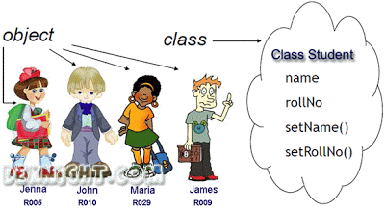
Difference between class v object:

Slide 36
Print stream
System.out.println("Hello Java");
System.out.println(“welcome Java");
output:
1st line : Hello Java
2nd line : welcome Java
Println: go to next line
System.out.print("Hello Java");
System.out.print(“welcome Java");
output:
Only one line: Hello Java welcome Java
Print: remain same line

Slide 37
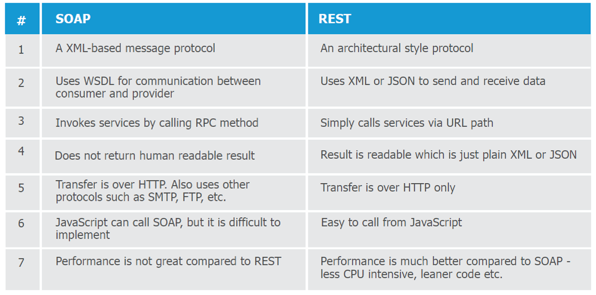

Slide 38
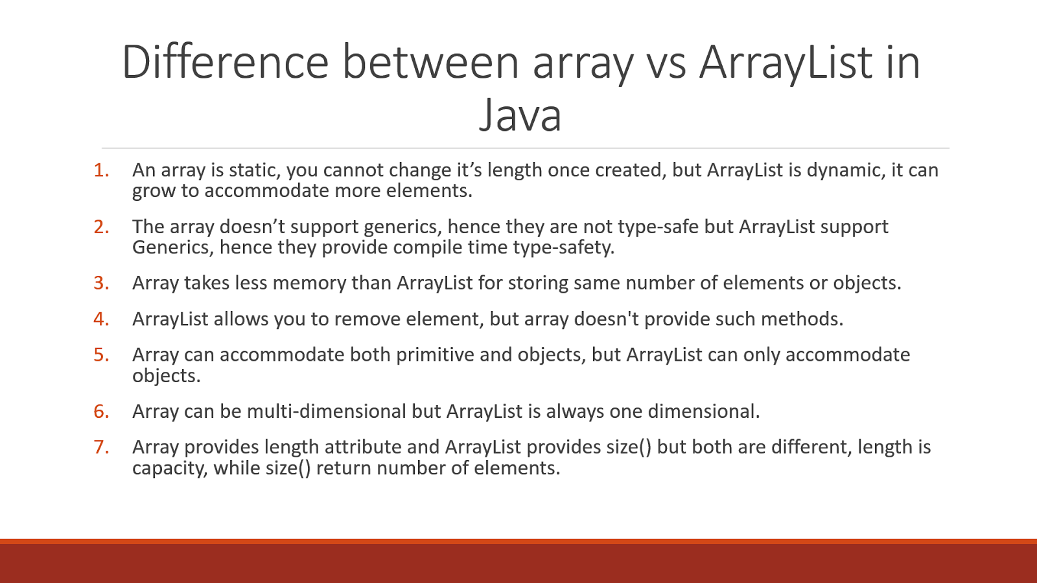

Slide 39
What is Locator?
Locator can be termed as an address that identifies a web element uniquely within the webpage. Locators are the HTML properties of a web element which tells the Selenium about the web element it need to perform action on.

Slide 40
There is a diverse range of web elements. The most common amongst them are:
Text box
Button
Drop Down
Hyperlink
Check Box
Radio Button

Slide 42
Java vs JS
JAVA | Java script
Server site testing | Browsed site testing

